Slide 1

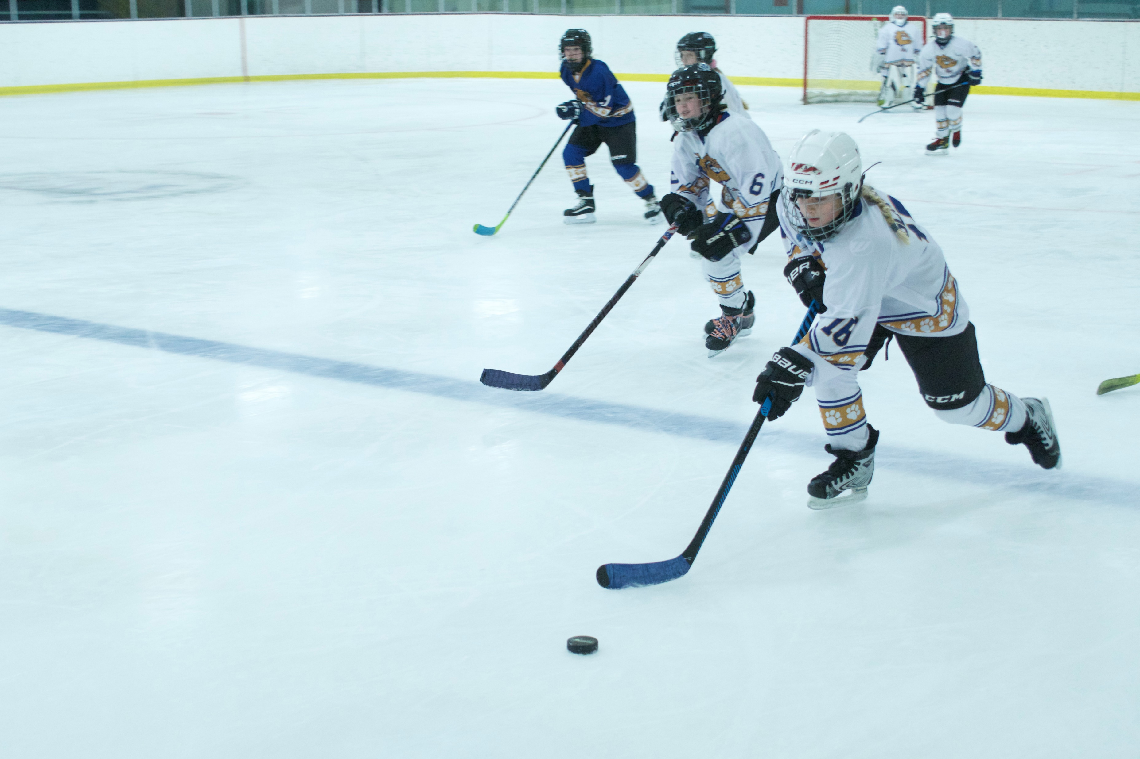
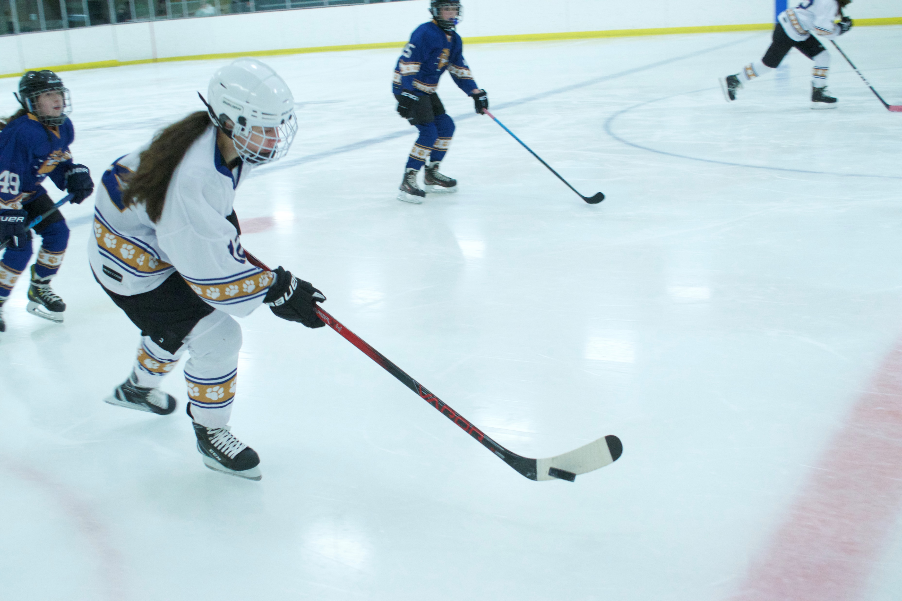
Garfield Heights Bulldogs
12U/14 U Girls Hockey
Sponsored by:
The City of Garfield Heights
Matt Burke, Mayor
Paul Birk, Sr., Director of Parks & Recreation
James Dirosa – Hockey Coordinator
Lindsay Glavan - Coach

Slide 2
Registration Begins June 15th
Girls! Let’s Play Hockey!
Girls Hockey has become more popular than ever!
We have the most affordable fees in North East Ohio, easily accessible and centrally located off of I-480.
This recreational program is for Girls born in 2010 to 2013. You can register during our summer open office hours. Normal summer hours are Tuesday through Friday 8:00 am – 6:30 pm and on weekends 1:45 pm – 6:30 pm. weather permitting & subject to change – pool will be closed on Mondays during our summer season. For those coming during the summer months to register - you can also plan on spending the day here at our “outdoor heated pool” & see what the other side of the rink is like! As an incentive to sign up early, there will be no charge for players and their immediate families – open swim hours are 2:00 pm – 7:00 pm Tuesday through Sunday.
The hockey season will begin mid-October through mid-March, averaging 2 hours of scheduled ice per week.
Check the schedule for some Stick & Puck sessions and/or Public sessions on this web page for extra ice & if you want to start skating earlier when the rink opens in mid-September and also during the season, just pay applicable fees separate from hockey fees.
Call – 216-475-7272, follow us on facebook @GarfieldHtsRec
sign up for reminders – text this message: @ghhockey to: 81010
Jim DiRosa, hockey coordinator- james.dirosa17@gmail.com – Lindsay Glavan, coach – Ghgirlshockey@gmail.com

Slide 3
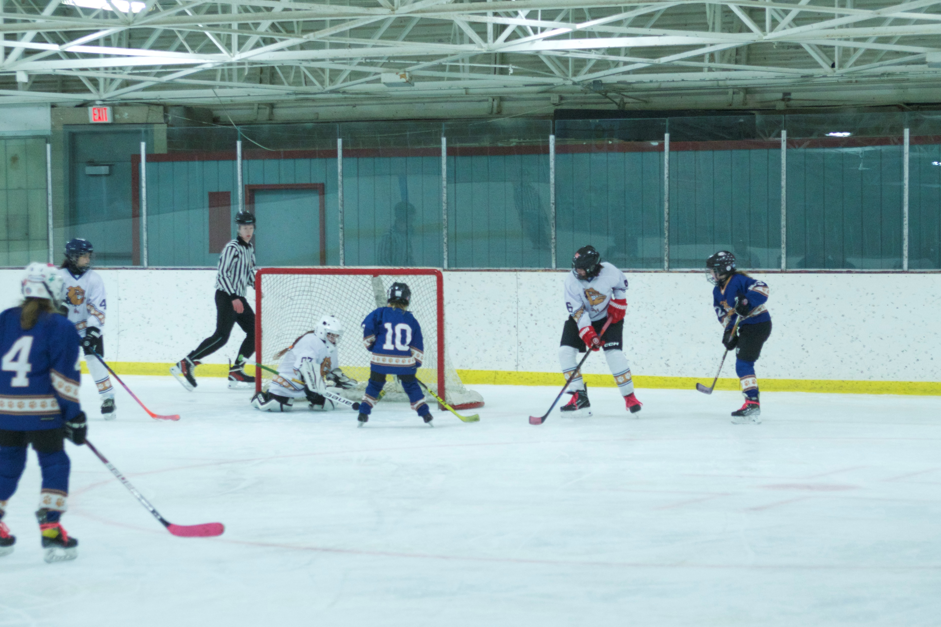
Fees:
Residents
Non- Residents
Recreation ID Card - $20.00
8 and up - $450.00
Referee Fees: $80.00
Referee fee paid separate at the time of registration – cash only
Total cost for the season - $550.00
Recreation ID Card - $50.00
8 and up - $710.00
Referee Fees: $80.00
Referee fee paid separate at the time of registration – cash only
Total cost for the season - $840.00

Slide 4
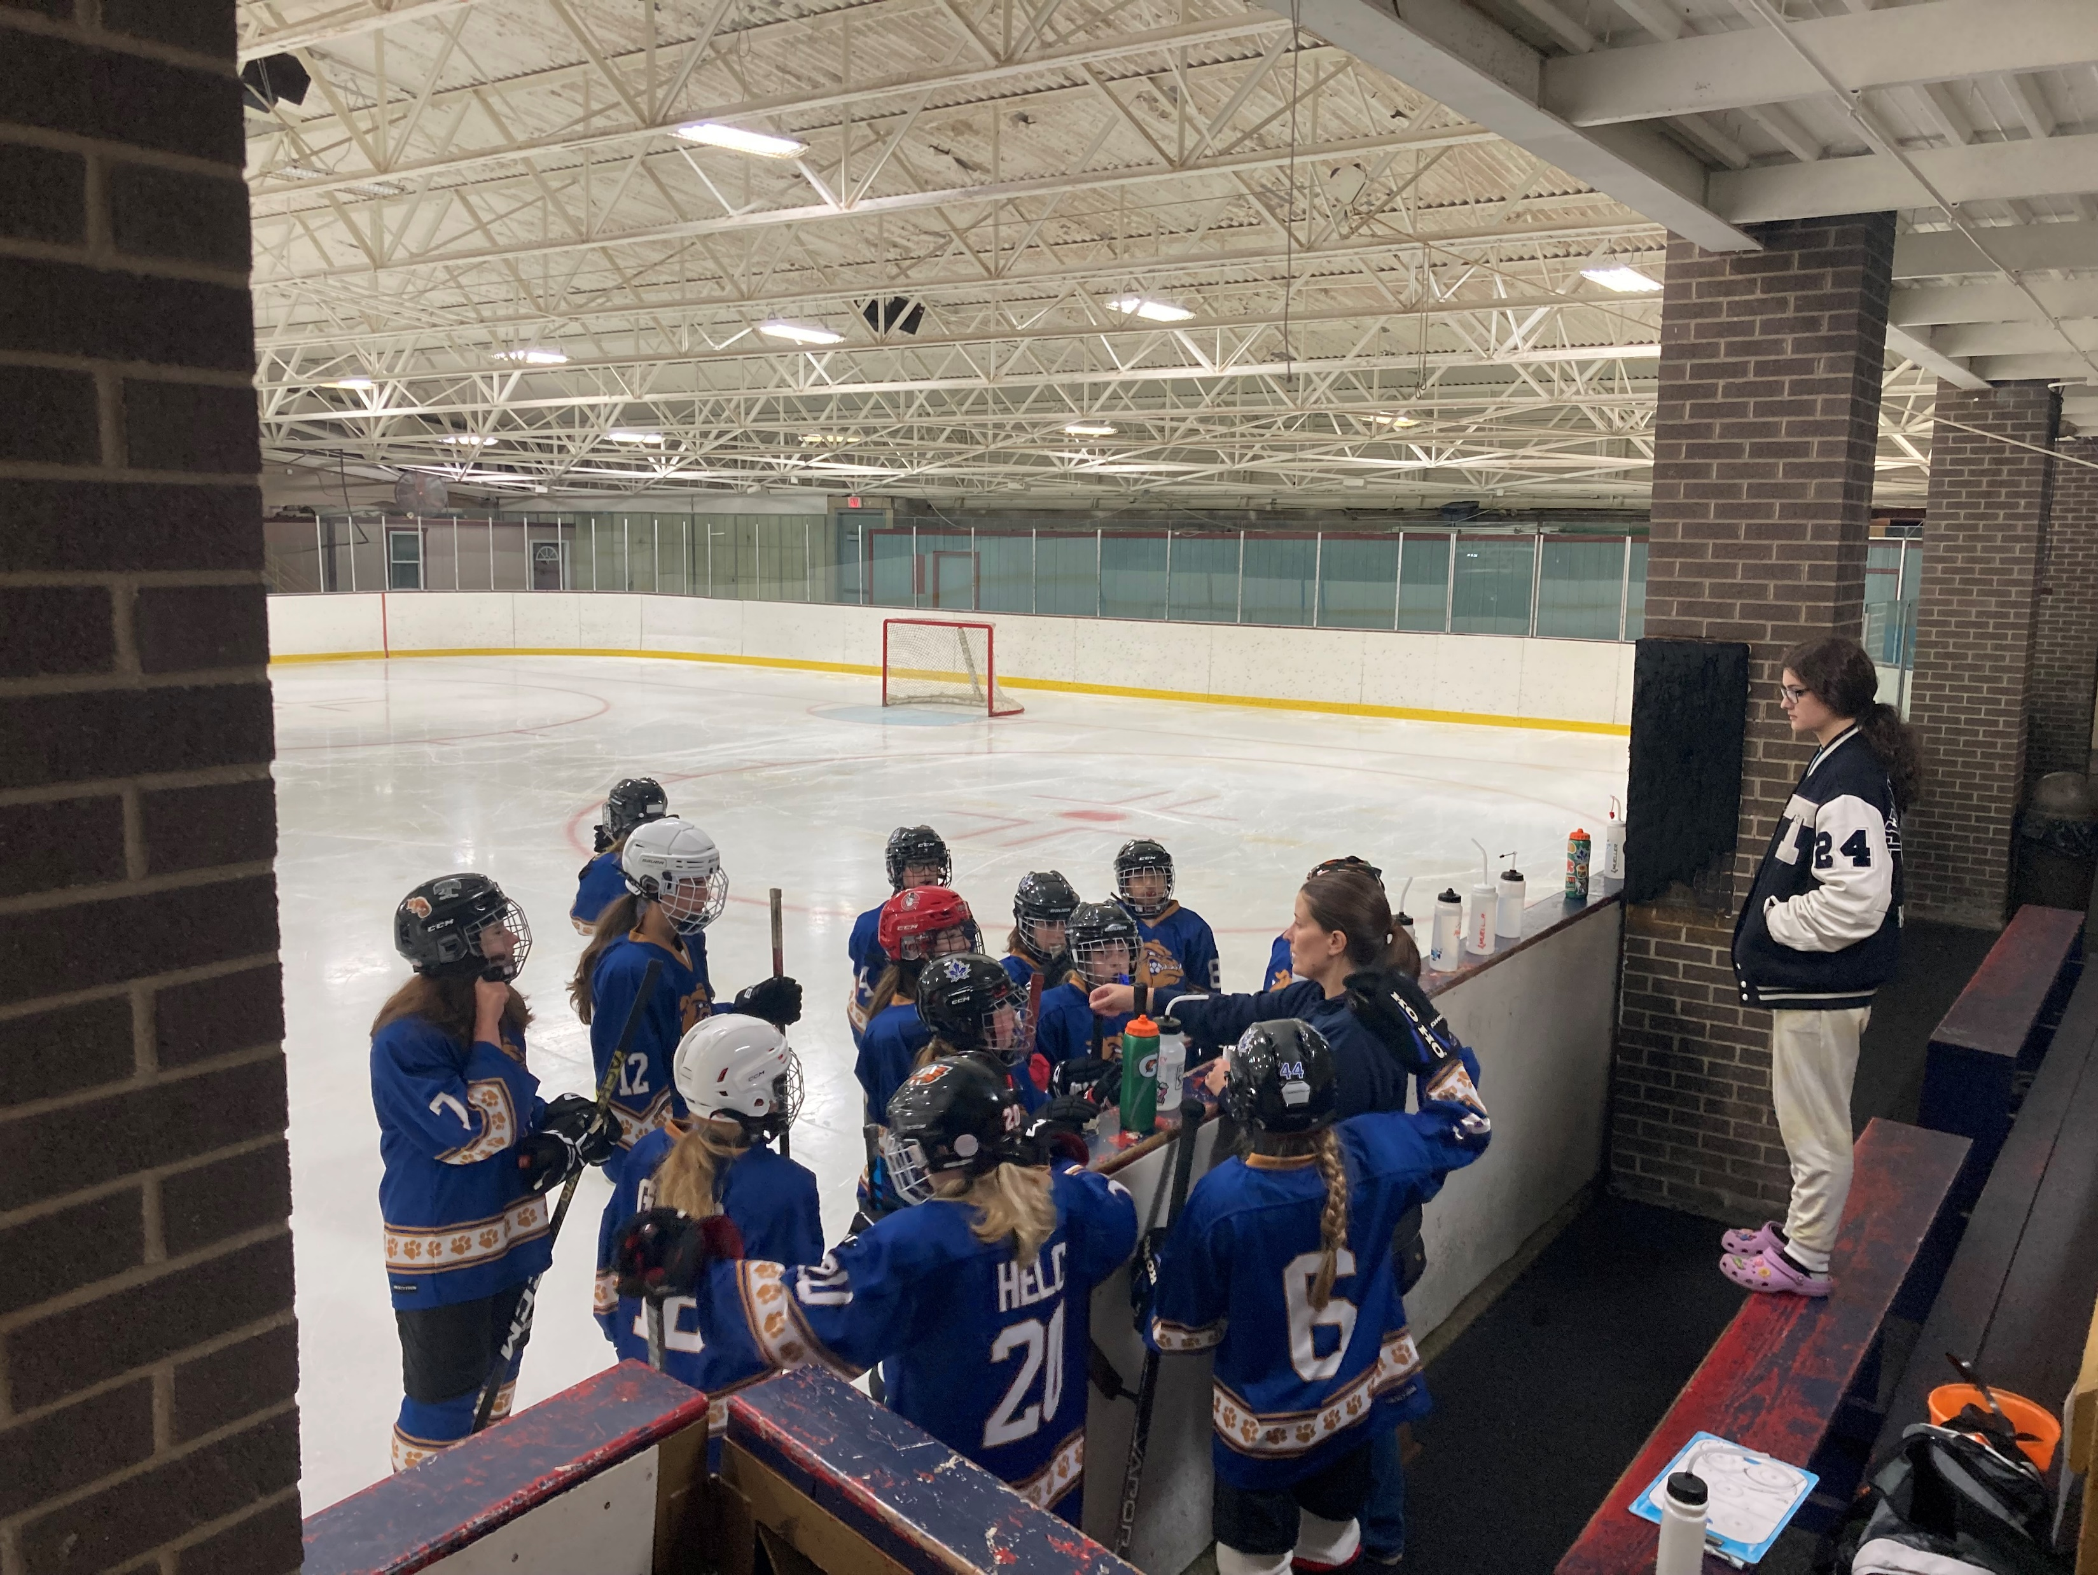
Mandatory at the time of Registrations:
Residents residing in Garfield Heights will need 2 current utility bills, a bank statement or pay stub for proof of residency. The City accepts cash, all major credit, debit cards and personal checks with proper ID (we do not accept American Express cards)
Copy of child’s birth certificate, only a parent or legal guardian can register a child.
U.S.A. Hockey insurance paid online separately at usahockey.com.
Confirmation of insurance must be submitted to the hockey coordinator/coach.

